Slide 1
COLLABORATIVE FILTERING ALGORITHM IMPLEMENTATION Using Probabilistic Matrix Factorization and Large-scale Parallel Collaborative Filtering using SVD with KNN
Group 6: Yanan Li (yl4062)
Daniel Weiss (dmw2180)
Bingquan Wu (bw2585)
Shijie Zhang (sz2781)
Na Zhuo (nz2297)
Notes:
Hello everyone, we are group6.
Our topic is the collaborative filtering algorithm implementation and comparison.
We tried to explore matrix factorization methods to solve recommendation system problems to perform better on sparse and imbalanced dataset
The two methods are A2 method Probabilistic Matrix Factorization and A3 method Large-scale Parallel Collaborative Filtering
Then we used P2 method: singular value decomposition(SVD) with KNN to do postprocessing.

Slide 2
Background
Companies are increasingly using advanced recommendation systems to recommend products to customers.
Netflix uses collaborative filtering, which refers to making automatic predictions about the interests of a user by collecting taste information from many users.
In our data, there are 610 users and 9724 movies but there are only 100836 rating information. Our task is to match consumers with products we predict they would rate higly
Matrix factorization models map both users and items to a joint latent factor space of dimensionality f.
q_{i} : movie factors p_{u} : user factors q_{i}^{T} p_{u} : user’s overall interest in movie i
Notes:
Companies are increasingly using advanced recommendation systems to recommend products to customers.
Netflix uses collaborative filtering, which refers to making automatic predictions about the interests of a user by collecting taste information from many other users.
In our data, there are about 610 users and 9724 movies but there are a lot of missing ratings. Our task is to match consumers with most appropriate products for the missing values.
Matrix factorization models map both users and items to a joint latent factor space of dimension f. Where the product of movie factors and user factors are the overall rating.
Our challenge is computing the mapping of each movie and user to the above factor vectors

Slide 3
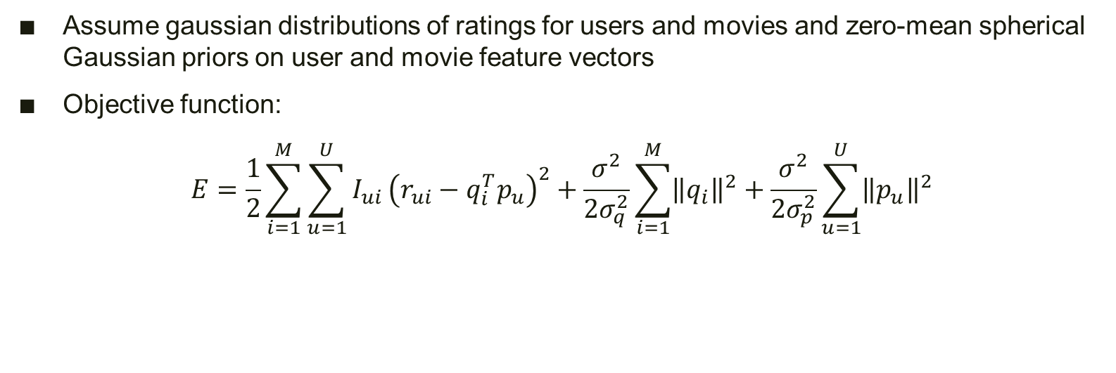
Probabilistic Matrix Factorization (PMF)
Assume gaussian distributions of ratings for users and movies and zero-mean spherical Gaussian priors on user and movie feature vectors
Objective function:
$$E=\frac{1}{2}\sum_{i=1}^{M}{\sum_{u=1}^{U}{I_{ui}}}{\left(r_{ui}−q_{i}^{T}p_{u}\right)}^{2}+\frac{σ^{2}}{2σ_{q}^{2}}\sum_{i=1}^{M}{{\left\|q_{i}\right\|}^{2}}+\frac{σ^{2}}{2σ_{p}^{2}}\sum_{u=1}^{U}{{\left\|p_{u}\right\|}^{2}}$$
r_{ui} : rating of user u for movie i
f : dimension of latent factors
q_{i}∈ R^{f}: factors associated with item i
µ=0, gaussian distribution
p_{u}∈ R^{f}: factors associated with user u
µ=0, gaussian distribution
I_{ui}: indicator function, equals 1 if user has rated movie, 0 if not
Notes:
The first method we use is the Probabilistic Matrix Factorization.
The assumption is that assume gaussian distributions of ratings and zero-mean spherical Gaussian priors on user and movie feature vectors
We aim to minimize the sum-of-squared-errors objective function with quadratic regularization terms.
The local minimum can be approached by gradient descent.

Slide 4
Probabilistic Matrix Factorization (PMF)
Benefits:
PMF scales linearly with the number of observations
Performs well on sparse and imbalanced datasets
Models the user preference matrix as a product of two lower-rank user and movie matrices
Original study found an error rate of 88.61%, almost 7% improvement over Netflix’s algorithm
Notes:
It performs well on sparse and imbalanced dataset.

Slide 5
PMF Parameter Tuning
n_{f}: number of latent factors
λ_{u}: squared ratio of rating variance to feature variance of user u
λ_{i}: squared ratio of rating variance to feature variance of movie i
The cross-validation is used for parameter selection with K=5
The number of epochs is 30
n_{f} | λ_{u} | λ_{i} | RMSE Train | RMSE Test
10 | 0.2 | 0.05 | 0.53 | 1.20
10 | 0.05 | 0.1 | 0.54 | 1.20
10 | 0.1 | 0.2 | 0.55 | 1.19
20 | 0.2 | 0.05 | 0.50 | 1.22
20 | 0.05 | 0.1 | 0.50 | 1.21
20 | 0.1 | 0.2 | 0.52 | 1.21
30 | 0.2 | 0.05 | 0.47 | 1.22
30 | 0.05 | 0.1 | 0.48 | 1.21
30 | 0.1 | 0.2 | 0.50 | 1.20
Notes:
We performed parameters tuning for the dimension of factor from 10 to 30
And the penalty parameter $\lambda$ for user and movie from .05 to .2 by 5-fold cross-validation.

Slide 6
PMF Parameter Tuning
Parameter:
number of latent factors (f) : 10; 20; 30
the λ for user (λ_u) : 0.05; 0.1; 0.2
the λ for movie (λ_v) : 0.05; 0.1; 0.2
The cross-validation is used for parameter selection with K=5
The number of epochs is 30
Notes:
We performed parameters tuning for the dimension of factor from 10 to 30
And the penalty parameter $\lambda$ for user and movie from .05 to .2 by 5-fold cross-validation.

Slide 7
number of latent factors | λ for user | λ for movie | RMSE_train | RMSE_test
10 | 0.2 | 0.05 | 0.53 | 1.20
10 | 0.05 | 0.1 | 0.54 | 1.20
10 | 0.1 | 0.2 | 0.55 | 1.19
20 | 0.2 | 0.05 | 0.50 | 1.22
20 | 0.05 | 0.1 | 0.50 | 1.21
20 | 0.1 | 0.2 | 0.52 | 1.21
30 | 0.2 | 0.05 | 0.47 | 1.22
30 | 0.05 | 0.1 | 0.48 | 1.21
30 | 0.1 | 0.2 | 0.50 | 1.20
Notes:
The result of the RMSE for train and test dataset tells that the best parameter combination is 30 latent factors and lambda for user be .1 and lambda for movie be .2

Slide 8
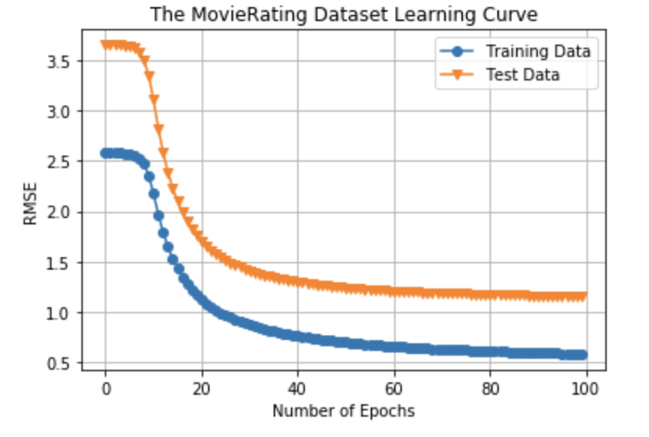
PMF Parameter Evaluation
Final Parameter:
number of latent factors (f) : 30 ; the λ for user (λ_u) : 0.1; the λ for movie (λ_v) : 0.2
RMSE for Train 0.54
RMSE for Test 1.15
Notes:
After the cross-validation, the final parameter is applied to Train and test data separately.
After one-hundred epoch, the RMSE for train achieves 0.54 and for test achieves 1.15.

Slide 9
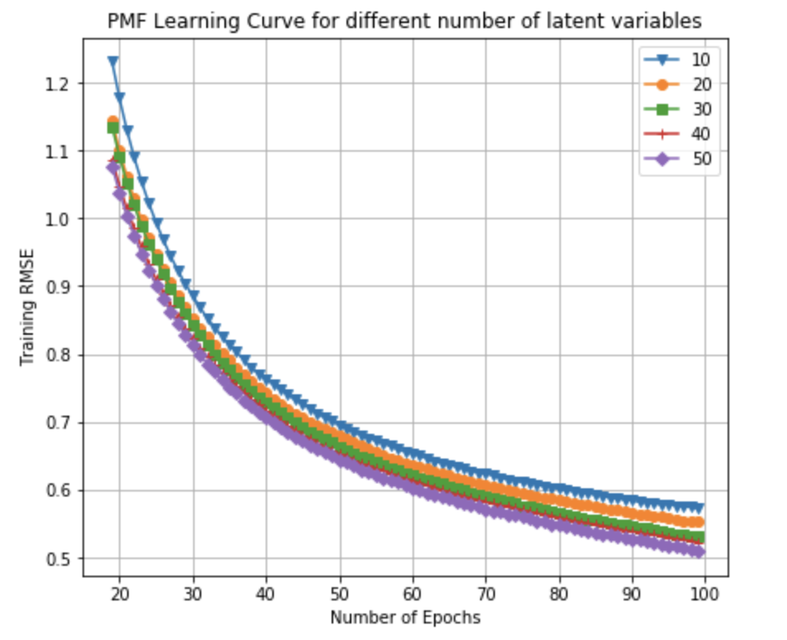
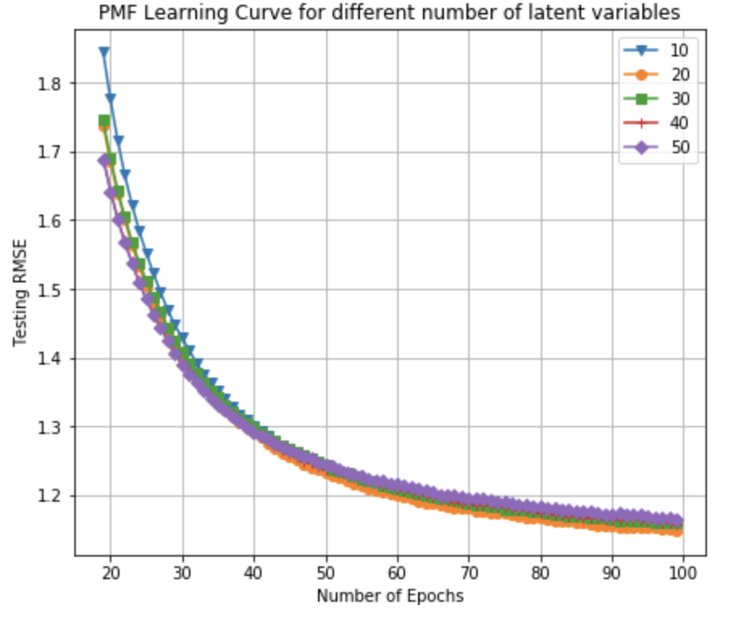
PMF Parameter Evaluation
fix λ_{u} to be 0.1 and λ_{v} to be 0.1 , change the number of features
Finally choose the number of features = 30
Notes:
To evaluate our parameter performance, a visualization is demonstrated with training and testing RMSE for different dimension of parameters and epochs.
The next three slides are our results

Slide 10
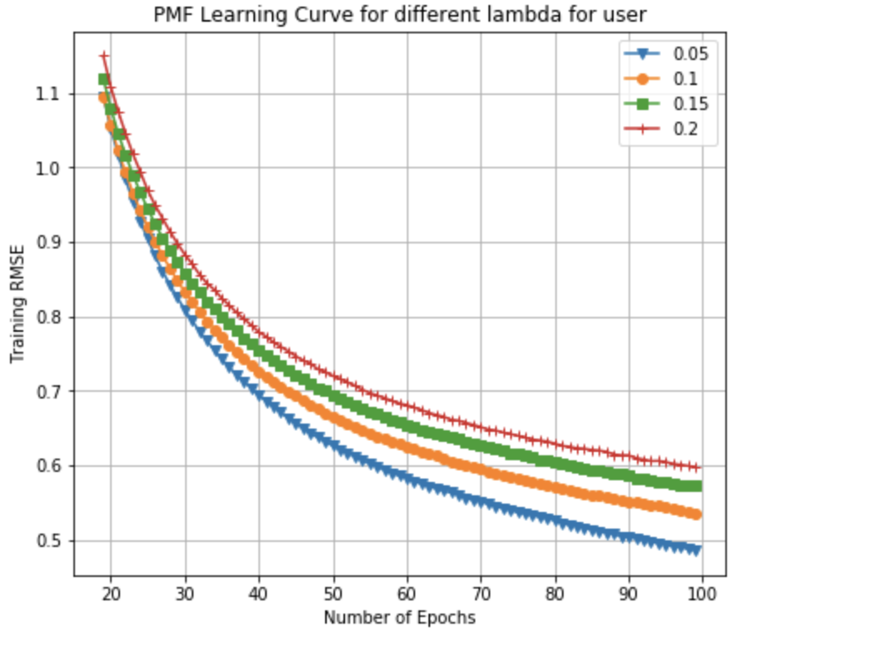
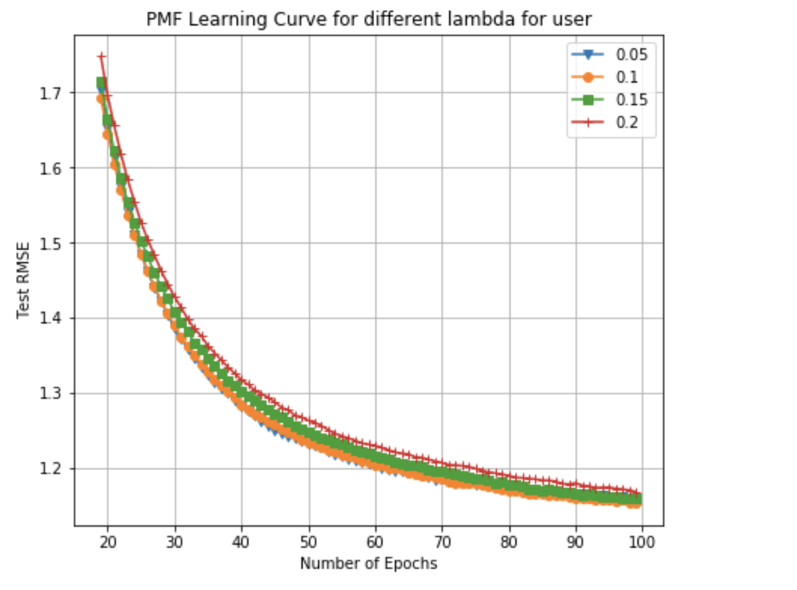
PMF Parameter Evaluation
fix number of features to be 30 and λ_{v} to be 0.2, change λ_{u}
Finally choose λ_{u} = 0.1

Slide 11
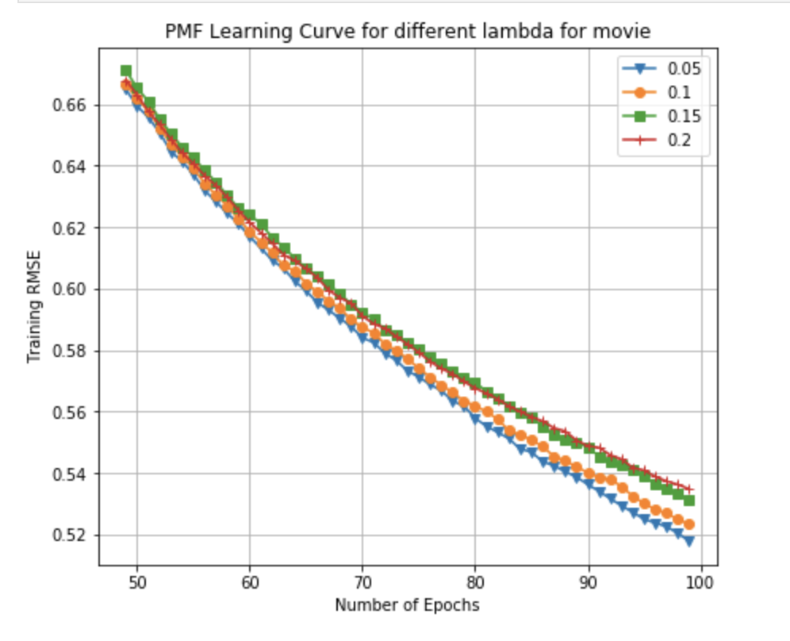
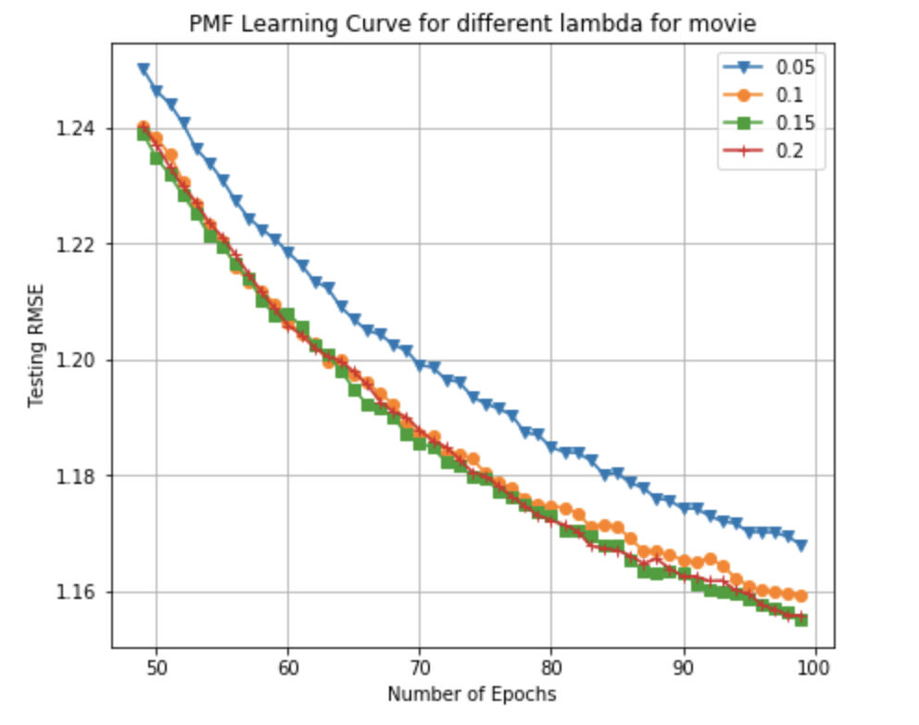
PMF Parameter Evaluation
fix number of features to be 30 and λ_{u} to be 0.1, change λ_{v}
Finally choose λ_{u} = 0.2

Slide 12
Large-scale Parallel Collaborative Filtering (LPCF)
A parallel algorithm that alternates least-squares with weighted λ-regularization
Refined using kNN
Achieves good results without date or movie title information
Parallel computing keeps this method fast and efficient
Uses a regularization term to effectively remove overfitting by penalizing large parameters
Benefits:
Scalable with large, sparse data
Original study found a 5.91% improvement over Netflix’s algorithm
Notes:
Another paper we read is about Large-scale Parallel Collaborative Filtering (LPCF) A parallel algorithm that alternates least-squares with weighted λ-regularization.
Scalable with large, sparse data

Slide 13
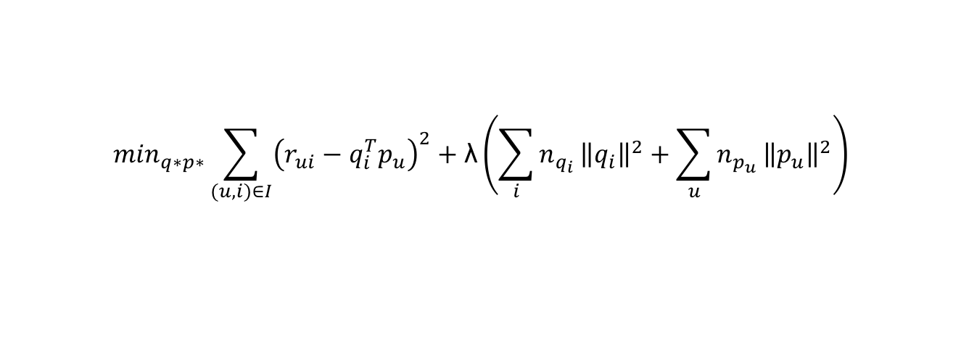
Alternative-Least-Squares with Weighted-λ-Regularization (ALS-WR)
Step 1 Initialize matrix M by assigning the average rating for that movie as the first row, and small random numbers for the remaining entries
Step 2 Fix M, Solve U by minimizing the objective function (the sum of squared errors)
Step 3 Fix U, solve M by minimizing the objective function similarly
Step 4 Repeat Steps 2 and 3 until a stopping criterion is satisfied
Objective function:
N_{qi}, n_{pu}: number of ratings of user u and movie i
$$\min_{q∗p∗}\sum_{(u,i)∈I}{{\left(r_{ui}−q_{i}^{T}p_{u}\right)}^{2}}+\text{λ}\left({\sum_{i}{n_{q_{i}}}\left\|q_{i}\right\|}^{2}+\sum_{u}{n_{p_{u}}}{\left\|p_{u}\right\|}^{2}\right)$$
Notes:
Another method we use is the Alternative-Least-Squares with Weighted-λ-Regularization (ALS-WR).
It solve the low-rank matrix factorization as the four steps above.
It can deal with the problems with too many missing elements in rating matrix R.
Also because there are many free parameters. without regularization, ALS might lead to overfitting.
Finally the weighted-λ-regularization works the best to avoid overfitting the test data when we increase the number of features or number of iterations.

Slide 14
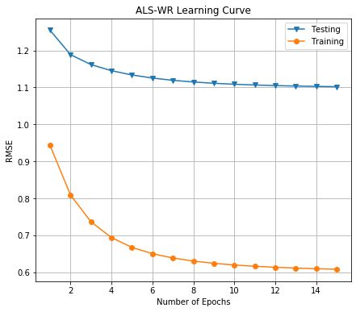
ALS-WR Parameter Tuning
The best parameters:
λ = 0.15, 𝑓 = 20
The Train RMSE: 0.61
The TEST RMSE: 1.102
Notes:
We performed parameters tuning for the dimension of factor from 5 to 50
And the penalty parameter $\lambda$ for user and movie from .05 to .2 by 5-fold cross-validation.
After the cross-validation, the final parameter is applied to Train and test data separately.
The final parameter is lamba equals 0.15 and f number of factors equals 20
After one-hundred epoch, the RMSE for train achieves 0.61 and for test achieves 1.102.

Slide 15
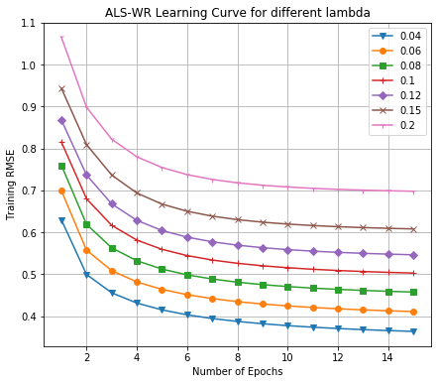
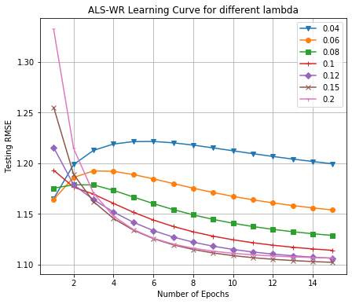
ALS-WR Parameter Evaluation
fix number of features to be 20, change lambda
Finally choose λ = 0.15
Notes:
To evaluate our parameter performance, a visualization is demonstrated with training and testing RMSE for different dimension of parameters and epochs.
The next two slides are our results

Slide 16
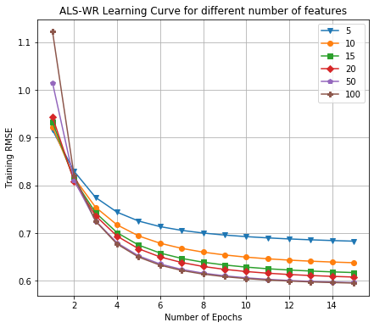
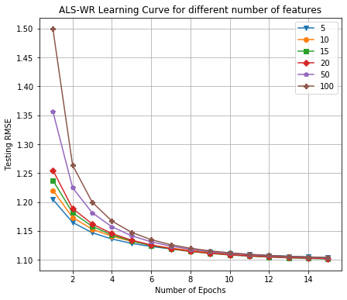
ALS-WR Parameter Evaluation
fix lambda to be 0.15, change number of features
Finally choose the number of features = 20

Slide 17
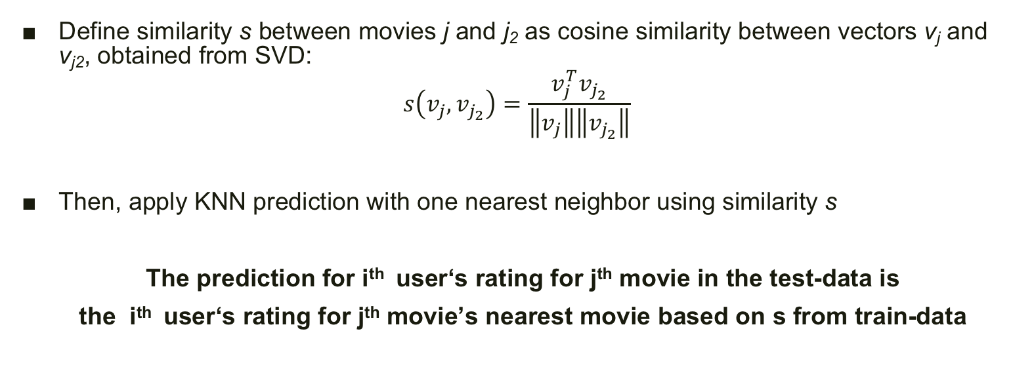
Post Processing: SVD with KNN
Define similarity s between movies j and j₂ as cosine similarity between vectors v_{j} and v_{j2}, obtained from SVD:
$$s\left(v_{j},v_{j_{2}}\right)=\frac{v_{j}^{T}v_{j_{2}}}{\left\|v_{j}\right\|\left\|v_{j_{2}}\right\|}$$
Then, apply KNN prediction with one nearest neighbor using similarity s
The prediction for i^{th} user‘s rating for j^{th} movie in the test-data is
the i^{th} user‘s rating for j^{th} movie’s nearest movie based on s from train-data
Notes:
For the posting processing step, the SVD with KNN is applied
The basic idea is that
First we define similarity s between movies j and j₂ as cosine similarity between vectors v_{j} and v_{j2},
Then based the similarity s, we applied KNN to find nearest neighborhood
The final prediction for i^{th} user‘s rating for j^{th} movie in the test-data is the i^{th} user‘s rating for j^{th} movie’s nearest movie based on s from train-data

Slide 18
Evaluation and Results
The RMSE of the adjusted model
A2 method | A3 method
1.36 | 1.05
Notes:
The RMSE for the adjusted model for A2 and A3 method is 1.36 and 2.05
There is slight increase in the prediction error.
The main problem we think is that we only use one nearest neighborhood to do prediction.
Increase the number of K may improve accuracy.
But overall the A2 method performs better in this dataset.

Slide 19
THANK YOU

